Slide 1
AN ORAL PRESENTATION ON Maize Disease Detection and Classification Based on Deep Neural Network for substantiating the crop yield
BY
ADEBOWALE ANU VICTOR
SEN/19/0689
DEPARTMENT OF SOFTWARE ENGINEERING, SCHOOL OF COMPUTING.
SUPERVISED BY: PROF. K. G. AKINTOLA

Slide 2
INTRODUCTION
Maize is a cereal grain originating from the America’s, which grown worldwide now, it consist of “white maize and Yellow maize” ( Ikedike, 2022).
Detection is a process of finding out about items features.
Classification is a process of putting items into different bins.
CNN also called ConvNet is a specialized deep learning algorithm primarily used for tasks like image recognition, object detection, and classification.
Diseases that occur at the early stage of maize crop pose a significant threat to production of maize, leading to reduced yields, subsistence and commercial losses, finally economical losses.
CNN is proposed as a solution for the detection and classification of maize diseases in this research.

Slide 3
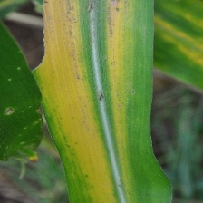
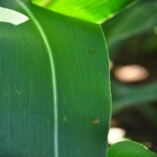
RESEARCH MOTIVATION
Time consumption spent in using the traditional method of maize disease detection
The Insufficient use of diverse maize leaves with different diseases.
These results also support the fact that deep learning models require huge number of training samples to learn and capture the inherent features from the data under study(Haque, 2019).

Slide 4
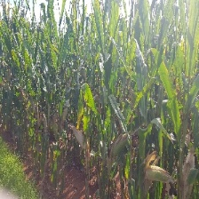
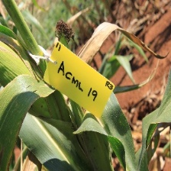
RESEARCH OBJECTIVES
The objectives in this research are to:
Develop a deep learning model for Early detection of Maize Diseases
Implement the model to classify the detected diseases.
Carry out the case study of the model.

Slide 5
LITERATURE REVIEW
S/N | Description | Motivation | Objective(s) | Methodology |  | Limitation(s)
1 | Nidhi et al., (2022). Disease detection, severity prediction, and crop loss estimation in maize using deep learning | The increasing gap between the demand and productivity of maize crop in the food industry. Manual detection and classification of these diseases, calculation of disease severity and crop loss estimation is a time-consuming manual task. | Automatic disease detection 2. Automatic crop loss detection Automatic disease classification | The method involved the use of image dataset from a pant pathologist, the image dataset made use of k-means algorithm algorithm for segmentation. The images where then feed to a CNN model called MaizeNet which comprise of nine convolutional layers and three max pooling layers. The flatten layer was able to output four classes namely: Healthy, TLB, Rust and multi-diseases. |  | Limited classes of disease consideration Use of complex CNN model on smaller dataset which could result into overfitting
2 | Kshyanaprava et al., (2020). Maize Disease Detection and classification using ML algorithm | The continuous reduction in the yield of maize crop production in the country and time and cost consumption in assessment of the quality of crop through visual inspection. | Detection of maize diseases using ML. Classification of maize diseases using ML | The approach the authors used was that they acquired labelled data set converted them to grayscale, segmented those labelled dataset. After that the segmented dataset, the features were extracted and six machine learning classifiers were used to classify each dataset. |  | Limited Feature consideration Insufficient use of feature extraction techniques. The use of secondary dataset

Slide 6
LITERATURE REVIEW
S/N | Description | Motivation | Objective(s) | Methodology |  | Limitation(s)
3 | Sahil et al., (2023). Convolutional Neural Network Based Maize Disease Identification. | The author saw the diverse importance of maize crop in agriculture and how it production helped his country Indian in cereals production. The occurrence of maize disease posed a threat to the production and has led to reduction in quantity and quality of cereal across the country.. | Detection of maize disease in the early stage. Bicategory classification of maize disease using CNN | The methodology used started with data acquisition from plant village, the next step was using the following data preprocessing techniques; log transformation, CLAHE and Log+CLAHE on each channel of the RGB color space. After preprocessing of the images they made use of CNN network to train the dataset and finally used it for bicategorical classification. |  | The limitation from these authors was that they made use of secondary dataset which sometimes are not well labelled and might not seem fit for real life application
4 | Sibiya et al., (2019). A computational procedure for the recognition and classification of maize leaf disease out of healthy leaves using CNN | The effect of disease affects maize production in South Africa and the time consumption used in traditional detection of disease in maize and classification of these diseases | Development of a CNN network that detects maize diseases. Implementation of the CNN network that Classifies of maize diseases. | The method started with data acquisition which the authors got using real life data captured on phone, they proceeded to label and resizing the datasets. The resized dataset were feed to a convolutional neural network with 50 hidden layers. Finally, the CNN was used in detecting three maize diseases. |  | The Authors only considered few maize diseases. The CNN network used in this research were complex and well constructed but the they trained this model with 100 data set which would lead to overfitting when it is deployed to real life scenario.

Slide 7
LITERATURE REVIEW
S/N | Description | Motivation | Objective(s) | Methodology |  | Limitation(s)
5 | Biplob et al., (2022). Comparative performance of four CNN-based deep learning variants in detecting two fungal diseases in Rice. | 1. Decrease in the yield of rice in Asia due to these fungal. 2. Integration of AI and rapid technological development in the Agricultural domain. | Evaluation of the comparative performance of a basic CNN and four advance CNN models in detecting various diseases in rice. | A total of 2892 leaf images were acquired, 800 were real life datasets while the others were gotten from an online source. The collected dataset were resized to 256 * 256 pixel height and width. The author made use of a five convolutional layer and an average pooling layer for predicting seven classes of maize leaves. |  | It was observed that it the authors only resized the images and use no preprocessing techniques which could improve the accuracy of the model.
6 | Haque et al., (2019). Deep learning‑based approach for identification of diseases of maize crop | The important of maize to the authors country’s agriculture sector. The impact of these diseases caused a increase in the reduced yield of maize. | Develop a Deep Learning Model for maize diseases detection using imaging. Comparison with Pre-trained Models. | Images of maize crops were captured from experimental fields, targeting three specific diseases: MLB, TLB, and Banded Leaf and Sheath Blight (BLSB). Various deep learning models, including Inception-v3, were trained using different data configurations. The models were evaluated based on their classification accuracy and computational efficiency |  | Computational Cos Class Confusion Need for Large Dataset.

Slide 8
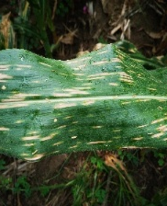
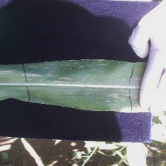
RESEARCH METHODOLOGY
Data collection
Data Pre-processing
Model Development
Model Training
Model Classification
Evaluation Metrics

Slide 9
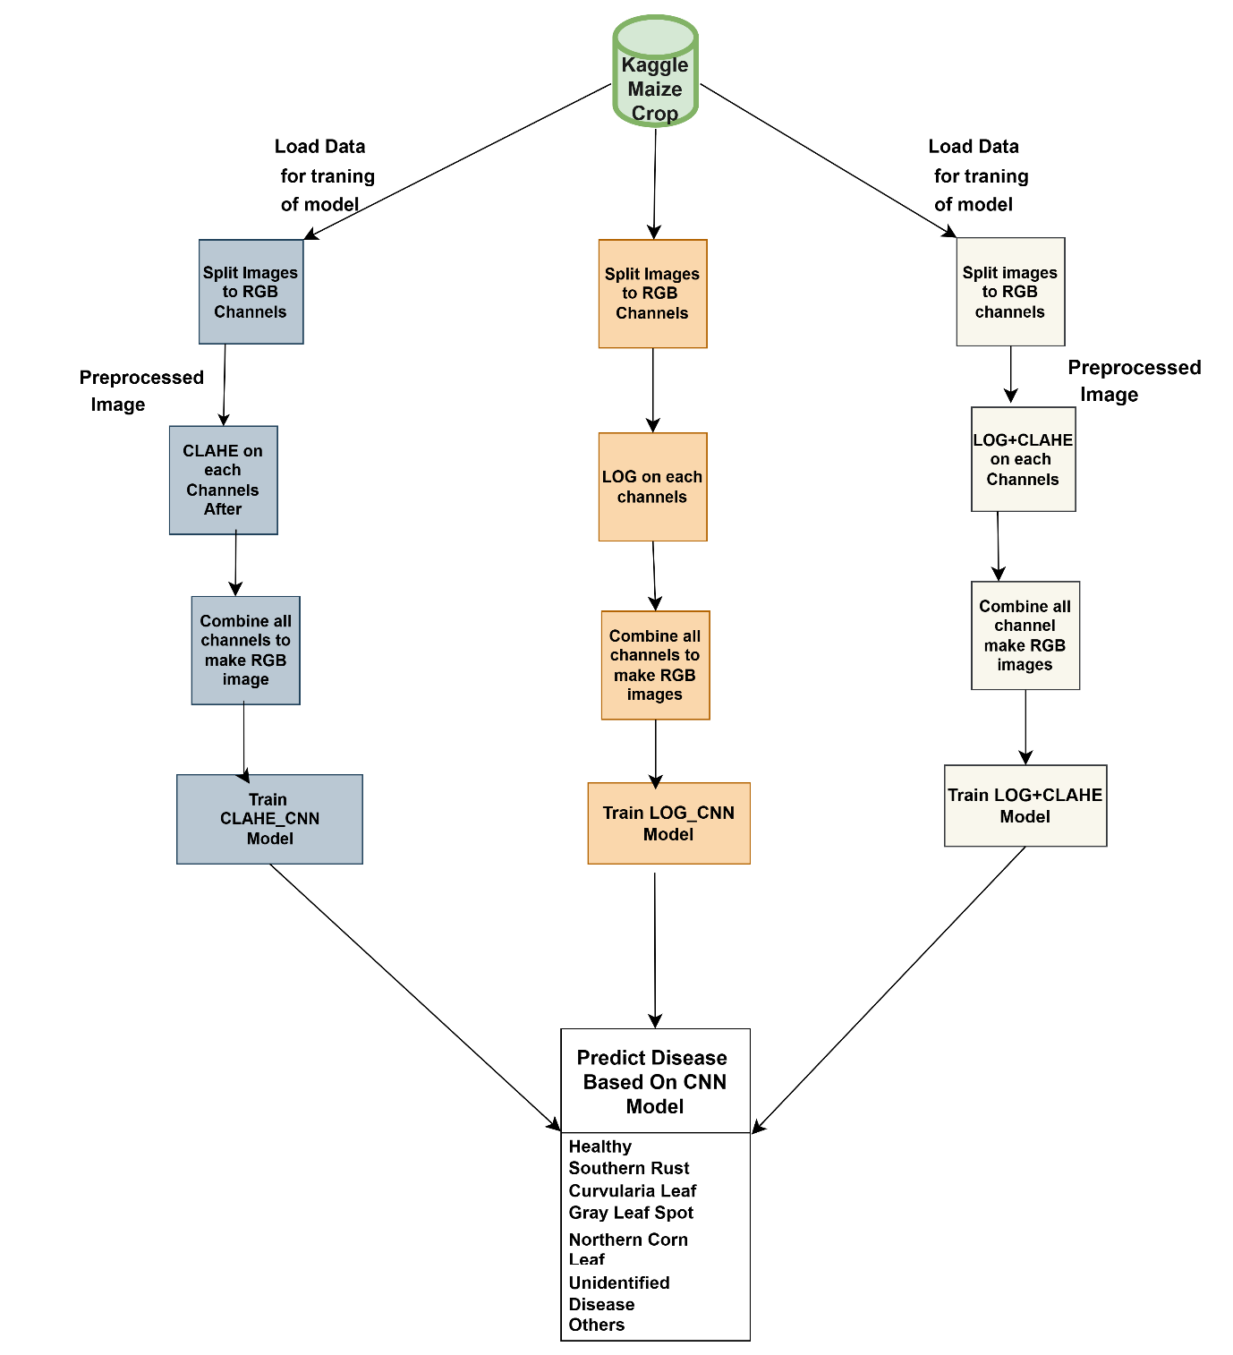
RESEARCH METHODOLOGY CONT’D ARCHITECTURE
Architecture

Slide 10
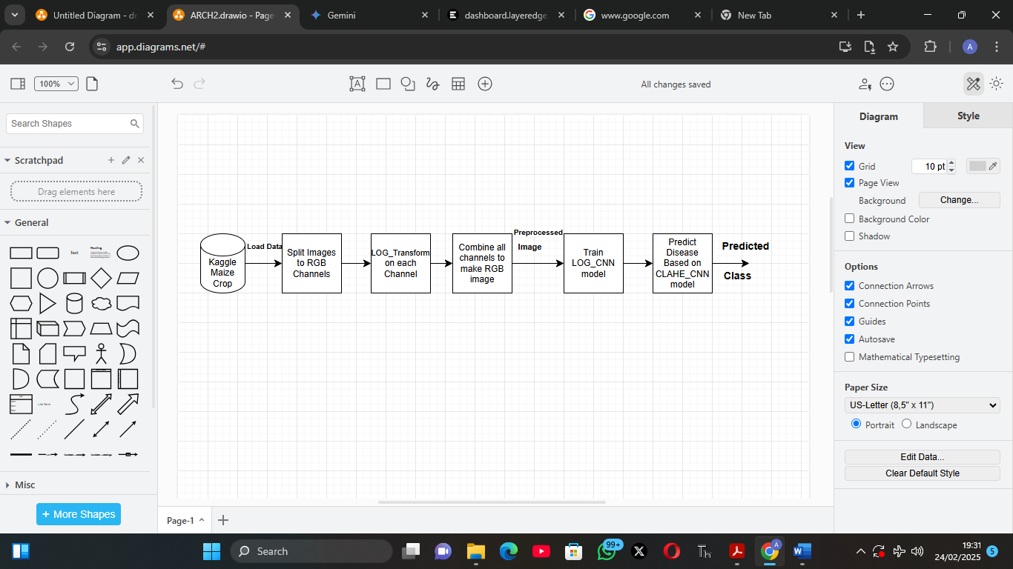
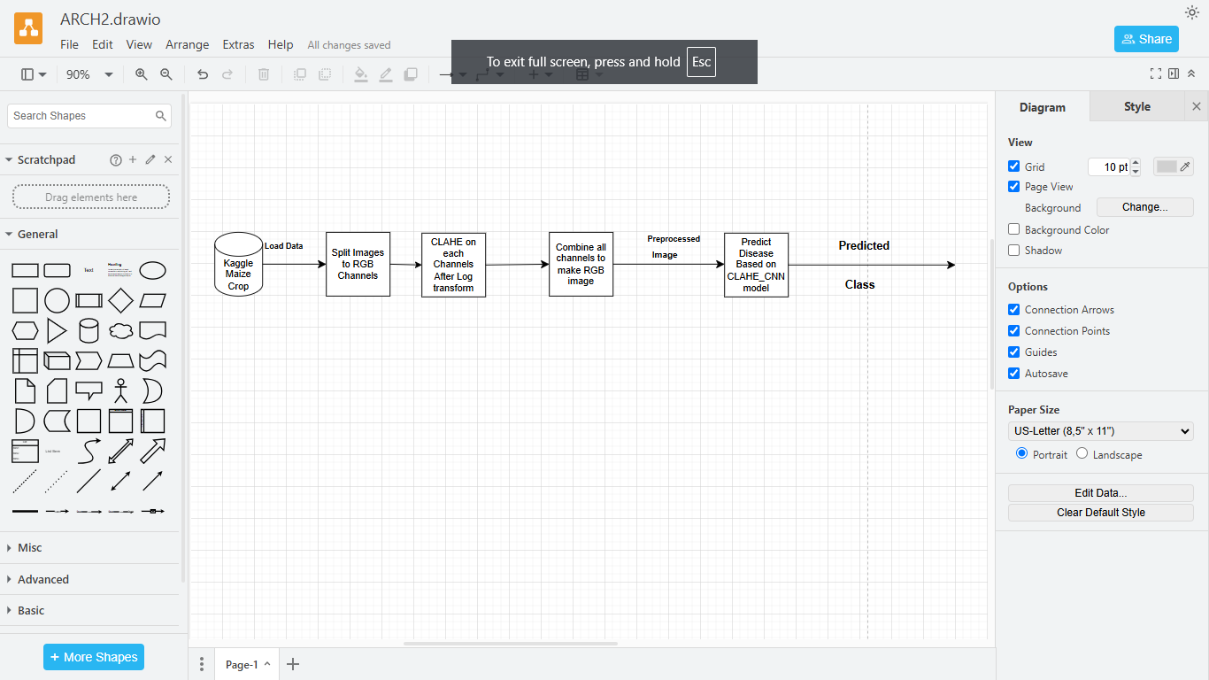
RESEARCHER METHODOLOGY CONT’D Log_CNN AND CLAHE_CNN ARCHITECTURE

Slide 11
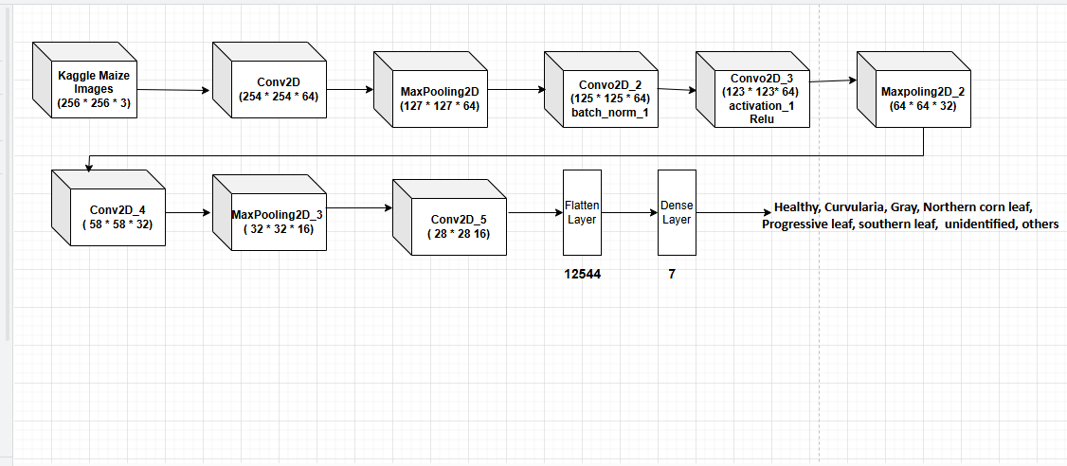
RESEARCH METHODOLOGIES CONT’D
CNN ARCHITECTURE

Slide 12
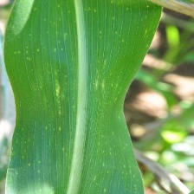
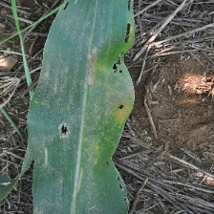
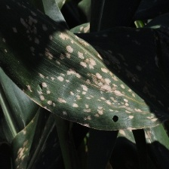
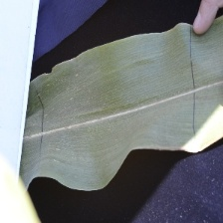
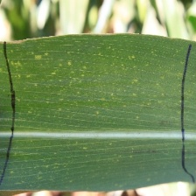
EXPECTED CONTRIBUTION TO KNOWLEDGE
This project will provide a model for detection and classification of maize diseases that will aid prompt and accurate treatment of diseases in maize.

Slide 13
REFERENCES
Biplob, D., Mohammed, M., Ul, H., Rahela, K., and Romel, A. (2022). Comparative performance of four CNN-based deep learning variants in detecting two fungal diseases in Rice. International Journal of Agricultural and Biological Engineering, 18-24. : https://www.sciencedirect.com/science/article/pii/S0168169922006494.
Kshyanaprava, P. P., Himansu, D., Abhaya K. S., and Suresh, Chandra M. (2020). Maize Disease Detection and classification using ML algorithm. Progress in Computing, Analytics and Networking, Advances in Intelligent Systems and Computing 1119, https://doi.org/10.1007/978-981-15-2414-1_66
Sahil, J., Jyotsna, Y., Navin R., Mukta A., and Juhi, C. (2023). Convolutional Neural Network Based Maize Disease Identification. Peer-review under responsibility of the scientific committee of the International Conference on Machine Learning and Data Engineering. https:// creativecommons.org/licenses/by-nc-nd/4.0.
Malusi, S., and Mbuyu, S. (2019). A computational procedure for the recognition and classification of maize leaf disease out of healthy leaves using CNN. AgriEngineering 2019, 1, 119–131; doi:10.3390/agriengineering1010000. www.mdpi.com/journal/agriengineering

Slide 14

FOR LISTENING!

